Slide 1
Modeling of Production and Logistics Systems
Lectures
Jan Fábry
5/13/2022

Slide 2
Contents
Models of management of production systems
Management of production systems
Production planning
Production scheduling
Basic terms
Production scheduling models
Single machine scheduling models
Extensions of basic single machine scheduling model
Parallel machine models
Flow shop scheduling
Computer simulation
Introduction to computer simulation
Data anlysis
Basic terms of production systems
Basic model of production system
Management concepts and types of production systems
Forecasts
Phases of production systems analysis
Models of designing production systems
Product designing
Placement of facilities
Product schedule

Slide 3
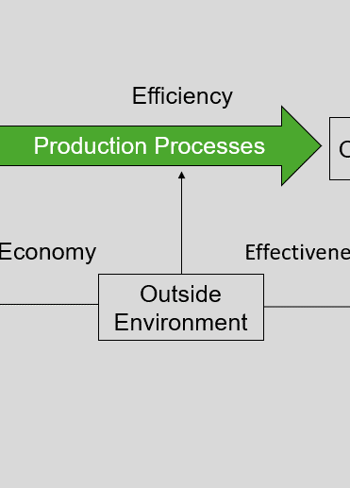
Basic terminology of production systems
1

Slide 4
Basic terminology of production systems
Basic model of production system
3E strategy
Economy
Efficiency
Effectiveness
Efficiency
𝑧=𝑇𝑅−𝑇𝐶 𝑇𝑅=𝑝𝑞 𝑇𝐶=𝐹𝐶+𝑉𝐶 𝑉𝐶=𝑣𝑞 𝑧=𝑝𝑞−(𝐹𝐶+𝑣𝑞)=(𝑝−𝑣)𝑞−𝐹𝐶
Efficiency
Inputs
Production Processes
Outputs
Economy
Effectiveness
Outside Environment

Slide 5
Basic terminology of production systems
Basic model of production system
STEEP analysis
S = social
T = technological
E = economic
E = ecological
P = political
SWOT analysis
S = strenghts
W = weeknesses
O = opportunities
T = threats
Influence of external factors on the production system
Existing situation of the company in relation to its outside environment

Slide 6
Basic terminology of production systems
Management concepts and types of production systems
Main functions of management
planning,
decision making,
organizing,
leadership,
control.
Development of managerial strategies
Present
Speed
Quality
Cost
Production volume
Time

Slide 7
Basic terminology of production systems
Management concepts and types of production systems
Basic managerial conceptions
JIT (Just-in-Time) – the required quantity at the required time.
Lean Production System – elimination of useless processes, quality improvement.
TOC (Theory of Constraints) – elimination of bottlenecks, optimising throughput.
TQM (Total Quality Management) – comprehensive quality management, benchmarking.
QRM (Quick Response Manufacturing) – speeding up processes, shortening delivery times.
TEI (Total Employee Involvement) – employee involvement in quality improvement.
BPR (Business Process Reingeneering) – changing business processes to improve the competitiveness of the company.
Agile Manufacturing – the aim is to respond quickly to customer needs.
SCM (Supply Chain Management) – optimising supply chains.

Slide 8
Basic terminology of production systems
Management concepts and types of production systems
Types of production systems
Type of operations
production operations – transformation of inputs into outputs, easier measurability of quality,
non-production operations – providing services, closer contact with customers.
Type of product
production companies,
service companies,
companies providing products and services.
Type of production
production to stock – stock based on an estimate of expected orders,
production to order (contract) – special customer requirements,
assembly to order (contract) – a combination of both, the product is assembled according to a special order from stocked components.

Slide 9
Basic terminology of production systems
Management concepts and types of production systems
Types of production systems
Type of production
job production - low repeatability, high variability,
batch production - the same products are produced consecutively in a certain quantity (in a series),
mass production - high level of repeatability, low level of variability.

Slide 10
Basic terminology of production systems
Forecasts
Time
short range forcasts (up to 1 year),
medium range forcasts (1-5 years),
long range forecasts (over 5 years).
Focus
technological forecasts – estimation of technical and technological progress,
economic forecasts – estimation of changes in values of basic economic indicators,
forecasts of future demand.

Slide 11
Basic terminology of production systems
Phases of production systems analysis
Designing production systems.
Management of production systems.
Measurement of production systems performance.
Improving the performance of production systems.

Slide 12
Basic terminology of production systems
Phases of production systems analysis
Designing production systems
Product designing – what will be produced?
Process designing – how will it be produced?
selection of technology,
capacity planning
long-term planning – high capital expenditures,
short-term planning – efficient use of existing equipment,
the location of the facilities – where the facilities will be placed,
the schedule of the facilities – the selection of the way of processing the products on the facilities
fixed position of the product (house, bridge, aircraft),
schedule by process (contract production),
schedule by product (batch production),
group (cell) schedule – grouping of facilities with similar operations.

Slide 13
Basic terminology of production systems
Phases of production systems analysis
Management of production systems
Aggregate planning
Management strategy
PUSH
PULL
Estimation of demad
Estimation of demad
Detailed planning
Inputs
Inputs
Process 1
Process 1
Process 2
Process 2
Process 3
Process 3
Outputs
Outputs
Multi-level planning
Determining batch sizes
Inside demand
Inside demand
Inside demand
Demand (Order)
Scheduling batches
Production management
Inputs
Process 1
Process 2
Process 3
Outputs

Slide 14
Basic terminology of production systems
Phases of production systems analysis
Measurement of production systems performance
Indicators
Economy – resource costs.
Efficiency – productivity (ratio of outputs to inputs), efficiency of resource involvement.
Effectiveness – quality of outputs:
Financial indicators – costs arising from poor quality or its prevention.
Operational indicators – percentage of rejects, size of waste, delivery delays.
Customer indicators – customer satisfaction.
Improving the performance of production systems
Change of production system
Reengineering – step (jump) change of performance.
Kaizen – continuous improvement of performance – method PDCA (Plan, Do, Check, Act), Deming cycle.

Slide 15
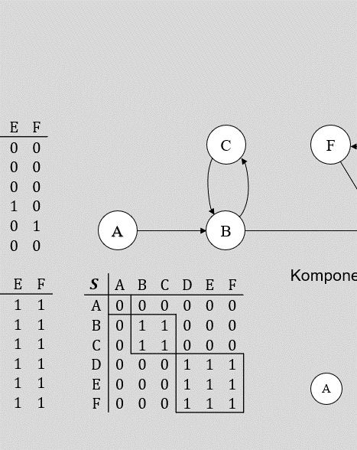
Models of designing production systems
2

Slide 16
Models of designing production systems
Product designing
Objectives of company
to bring new products to market as quickly as possible,
increase the level of customer satisfaction, improve quality (TQM)
reduce costs.
Means for designing
using standards,
Quality Function Deployment (QFD),
collaborative designing.

Slide 17
Models of designing production systems
Product designing
Using standards
VDA (Verband der Automobilindustrie),
modular designing – grouping of components into modules (easy and quick replacement),
CAD (Computer-Aided Design), CAM (Computer-Aided Manufacturing), CAE (Computer-Aided Engineering).
Quality Function Deployment (QFD)
a method developed in Japan in the 1960s,
the company develops and produces only what the customer expects,
using a method known as the "house of quality",
the advantages of
deepening the orientation on customer,
shortening the time of product development, reducing costs of development and production,
motivating collaborators to work together,
simplicity and clarity of the tool.

Slide 18
Models of designing production systems
Product designing
Collaborative designing
several designers are involved in the design process.
structured process,
a project with co-operative activities that can take place in the following relations:
serial – the following in succession,
parallel – can be performed simultaneously,
interconnected – must be performed simultaneously,
design structure matrix P:

Slide 19
Models of designing production systems
Product designing
Collaborative designing
co-operative networks,
example of 6 designers:
Undirected interactive
dialogue
C
F
E
Direct interactive relation
A
B
D
Serial relation

Slide 20
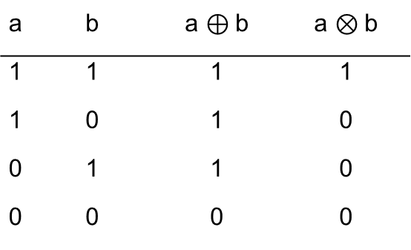
Models of designing production systems
Product designing
Analysis of information flows
the objective is to identify co-operating subgroups of designers,
boolean algebra can be used :
a | b | a $⊕$b | a $⊗$b
1 | 1 | 1 | 1
1 | 0 | 1 | 0
0 | 1 | 1 | 0
0 | 0 | 0 | 0

Slide 21
Models of designing production systems
Product designing
Analysis of information flows
Relation between elements through m direct relations: :
Relation matrix:
Two types of subsets of elements:
there is a mutual relation between elements,
no mutual relation between elements exists.

Slide 22
Models of designing production systems
Product designing
Analysis of information flows
Strong relation matrix S:
The matrix is symmetric and transitive.
The matrix can be rearranged into a matrix with a block-diagonal structure.
Designers in the block interact to each other.

Slide 23
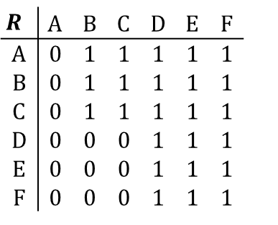
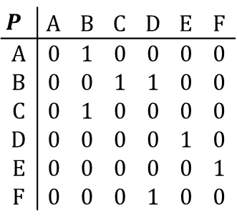
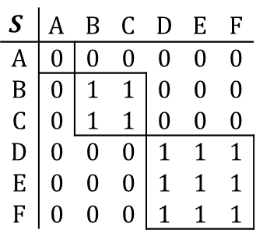
Models of designing production systems
Product designing
Analysis of information flows
Example
$$P^{ }$$ | A | B | C | D | E | F
A | 0 | 1 | 0 | 0 | 0 | 0
B | 0 | 0 | 1 | 1 | 0 | 0
C | 0 | 1 | 0 | 0 | 0 | 0
D | 0 | 0 | 0 | 0 | 1 | 0
E | 0 | 0 | 0 | 0 | 0 | 1
F | 0 | 0 | 0 | 1 | 0 | 0
C
F
E
A
B
D
$$R^{ }$$ | A | B | C | D | E | F
A | 0 | 1 | 1 | 1 | 1 | 1
B | 0 | 1 | 1 | 1 | 1 | 1
C | 0 | 1 | 1 | 1 | 1 | 1
D | 0 | 0 | 0 | 1 | 1 | 1
E | 0 | 0 | 0 | 1 | 1 | 1
F | 0 | 0 | 0 | 1 | 1 | 1
Components of a strong connection
$$S$$ | A | B | C | D | E | F
A | 0 | 0 | 0 | 0 | 0 | 0
B | 0 | 1 | 1 | 0 | 0 | 0
C | 0 | 1 | 1 | 0 | 0 | 0
D | 0 | 0 | 0 | 1 | 1 | 1
E | 0 | 0 | 0 | 1 | 1 | 1
F | 0 | 0 | 0 | 1 | 1 | 1
C
F
E
A
B
D

Slide 24
Models of designing production systems
Placement of facilities
Distance of the facility from
sources,
customers,
competitors,
other parts of system.
Other factors
market – demand and competition,
material – transport, labour, energy, etc.,
non-material – ecology, social attitudes, customer habits, etc.
Objectives
Connection of the new equipment with the existing production system?
How many types of products will the new facility produce?
How many new facilities will be placed?

Slide 25
Models of designing production systems
Placement of facilities
Methods for selection of location
Break-even point analysis.
Multiple criteria evaluation of alternatives.
Method of gravity center.
Facility location problem – modified transportation problem.
Facilities location problem – quadratic assignment problem.

Slide 26


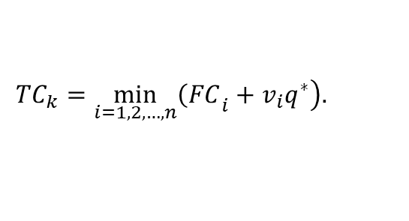
Models of designing production systems
Placement of facilities
Break-even point analysis
Equalization of total costs and total revenues (zero profit):
The total revenue is identical for all locations, i.e. the selection depends only on the total cost:
Selection of the location for given total production size 𝑞*:
$TC=TR$.
$${TC}_{i}={FC}_{i}+v_{i}q i=1,2,…,n.$$
$${TC}_{k}=\min_{i=1,2,…,n}\left.{\left(FC\right.}_{i}+v_{i}q^{∗}\right).$$

Slide 27
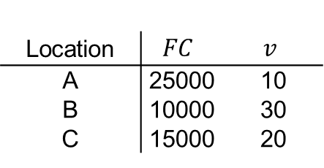
Models of designing production systems
Placement of facilities
Break-even point analysis
Example
Three potential locations for the new facility are given: A, B and C. The table shows the fixed costs in CZK per month and the variable costs in CZK per unit of production for each location.
Select a location for a known production of 800 units.
How does the selection of location depend on the production size in general?
Location | $$FC$$ | $$v$$
A | 25000 | 10
B | 10000 | 30
C | 15000 | 20

Slide 28
Models of designing production systems
Placement of facilities
Break-even point analysis
Example – continued
Total cost are shown in 1000 CZK, production size in 100 units.
TC
50
B
C
40
A
30
20
10
B
C
A
0
1
2
3
q
4
5
6
7
8
9
10
11
12
13

Slide 29
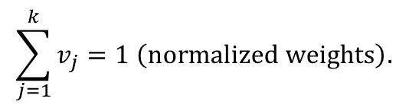

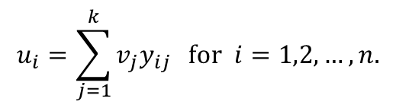
Models of designing production systems
Placement of facilities
Multiple criteria evaluation of alternatives
Locations are evaluated in terms of several criteria.
Weighted Sum Approach (WSA):
Evaluation of i–th alternative according to j–th criterion:
$y_{ij }$ for $i=1,2,…,n;j=1,2,…,k.$
Weight of j–th criterion:
$v_{j }>0$ for $j=1,2,…,k$,
Weighted sum:
$$\sum_{j=1}^{k}{v_{j}}=1 \left(normalized weights\right).$$
$$u_{i}=\sum_{j=1}^{k}{v_{j}y_{ij}} \text{for} i=1,2,…,n.$$

Slide 30
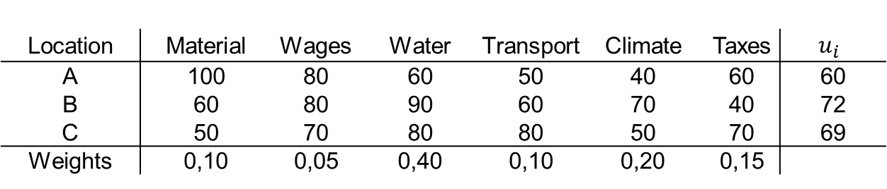
Models of designing production systems
Placement of facilities
Multiple criteria evaluation of alternatives
Example
Three potential locations for the new facility are given: A, B and C. Each option is evaluated according to seven criteria. The table shows the scores for each option according to the criteria and the weight of the criteria. The company is to select the location with the highest multi-criteria score.
Location | Material | Wages | Water | Transport | Climate | Taxes | $$u_{i}$$
A | 100 | 80 | 60 | 50 | 40 | 60 | 60
B | 60 | 80 | 90 | 60 | 70 | 40 | 72
C | 50 | 70 | 80 | 80 | 50 | 70 | 69
Weights | 0,10 | 0,05 | 0,40 | 0,10 | 0,20 | 0,15

Slide 31
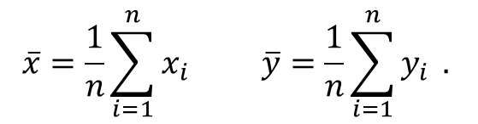
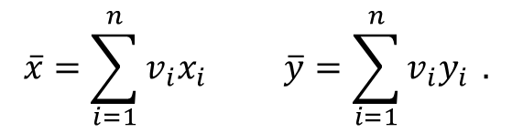


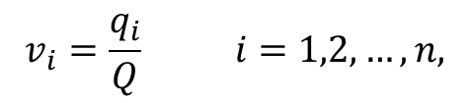

Models of designing production systems
Placement of facilities
Method of gravity center
Knowledge of existing network of parts of the system, i.e. coordinates of their locations:
Placement of the new facility in the center of gravity of the grid with coordinates:
Knowledge of transport volumes between facilities and the new facility:
Weights:
Coordinates of gravity center:
$x_{i}$a $y_{i}$for $i=1,2,…,n.$
$$\overline{x}=\frac{1}{n}\sum_{i=1}^{n}{x_{i}} \overline{y}=\frac{1}{n}\sum_{i=1}^{n}{y_{i}} .$$
$q_{i} for$ $i=1,2,…,n.$
$$Q=\sum_{i=1}^{n}{q_{i} .}$$
$$v_{i}=\frac{q_{i}}{Q} i=1,2,…,n,$$
$$\overline{x}=\sum_{i=1}^{n}{v_{i}x_{i}} \overline{y}=\sum_{i=1}^{n}{v_{i}y_{i}} .$$

Slide 32
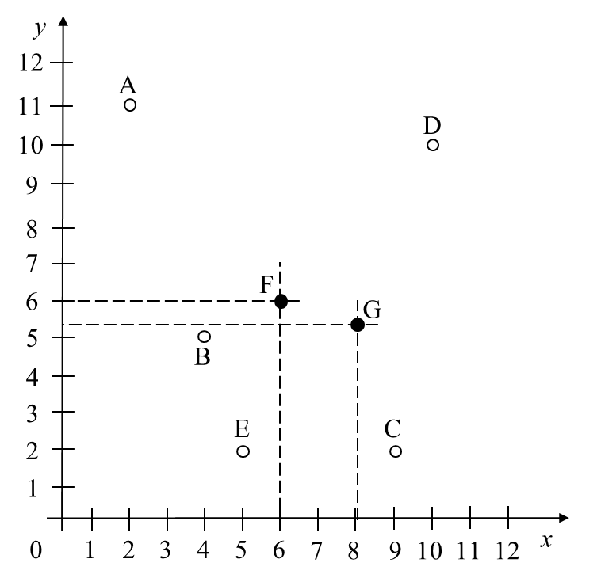
Models of designing production systems
Placement of facilities
Method of gravity center
Example – continued
Gravity center without transport volumes: (6;6)
Weighted gravity center: (8,1;5,3)

Slide 33
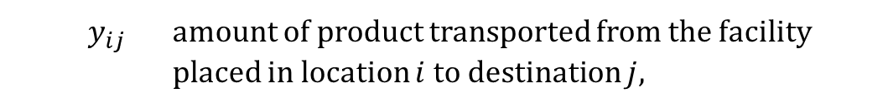




Models of designing production systems
Placement of facilities
Facility location problem – modified transportation problem
Set of m potential locations for new facilities:
Set of n destinations (customers or internal customers):
Transportation costs:
Variables:
$a_{i}$capacity of the facility in location $i,$
$$i=1,2,…,m.$$
$f_{i}$ fixed cost for the use of location $i,$
$$j=1,2,…,n.$$
$b_{j}$ demand of destination $j,$
$c_{ij}$shipping cost for transport a unit from source $i$ to destination $j$
$y_{ij}$ amount of product transported from the facility placed in location $i$to destination $j,$
$$i=1,2,…,m,$$
$$j=1,2,…,n.$$

Slide 34
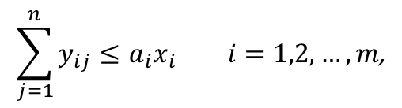
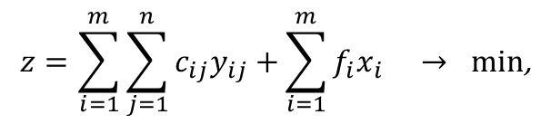


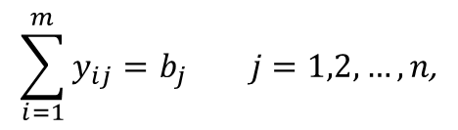
Models of designing production systems
Placement of facilities
Facility location problem – modified transportation problem
Mathematical model:
$$z=\sum_{i=1}^{m}{\sum_{j=1}^{n}{c_{ij}y_{ij}+}}\sum_{i=1}^{m}{f_{i}x_{i}} → \text{min}\text{,}$$
$$\sum_{j=1}^{n}{y_{ij}}≤a_{i}x_{i} i=1,2,…,m\text{,}$$
$$\sum_{i=1}^{m}{y_{ij}}=b_{j} j=1,2,…,n\text{,}$$
$$x_{i}∈\left\{0,1\right\} i=1,2,…,m\text{,}$$
$$y_{ij}≥0 i=1,2,…,m\text{.}$$

Slide 35
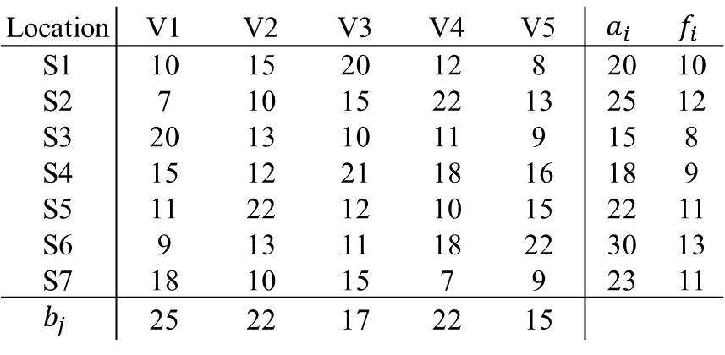
Models of designing production systems
Placement of facilities
Facility location problem – modified transportation problem
Example
The company can use seven potential warehouses from which to transport material to its five production sites. The table gives the monthly requirements of the production sites and the monthly capacities of the warehouses (in thousands of tons). If a warehouse is used, the company has to pay the amounts indicated for its monthly rent (in thousands of euros). In addition, unit shipping costs (in euro per ton) are charged for each transport from warehouse to production site. Decide which warehouses to lease and how much material to transport between the leased warehouses and the manufacturing plants so that the total monthly cost is minimal.

Slide 36




Models of designing production systems
Placement of facilities
Facility location problem – quadratic assignment problem
Set of n facilities:
Set of n locations (workplaces):
Variables:
$$i=1,2,…,n,$$
$c_{ij}$ material flow between facilities $i$and $j,$
$$j=1,2,…,n.$$
$d_{kl}$ distance between locations$k$and $l,$
$$k=1,2,…,n,$$
$$l=1,2,…,n.$$

Slide 37
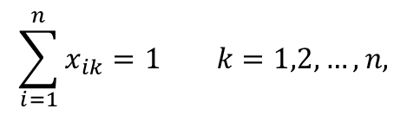
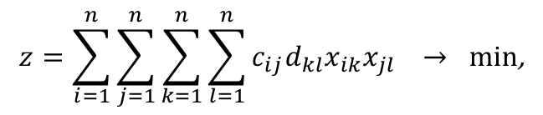

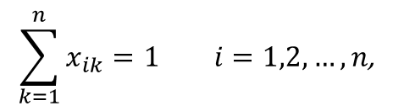
Models of designing production systems
Placement of facilities
Facility location problem – quadratic assignment problem
Mathematical model:
$$z=\sum_{i=1}^{n}{\sum_{j=1}^{n}{\sum_{k=1}^{n}{\sum_{l=1}^{n}{c_{ij}d_{kl}x_{ik}x_{jl}}}}} → min\text{,}$$
$$\sum_{k=1}^{n}{x_{ik}}=1 i=1,2,…,n\text{,}$$
$$\sum_{i=1}^{n}{x_{ik}}=1 k=1,2,…,n\text{,}$$
$$x_{ik}∈\left\{0,1\right\} \begin{matrix}i=1,2,…,n\text{,} \\ k=1,2,…,n\text{.}\end{matrix}$$

Slide 38

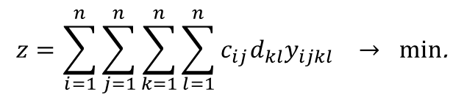
Models of designing production systems
Placement of facilities
Facility location problem – quadratic assignment problem
Linearization of mathematical model:
$y_{ijkl}≥x_{ik}+x_{jl}−1 i,j,k,l=1,2,…,n$,
$$z=\sum_{i=1}^{n}{\sum_{j=1}^{n}{\sum_{k=1}^{n}{\sum_{l=1}^{n}{c_{ij}d_{kl}y_{ijkl}}}}} → min\text{.}$$

Slide 39
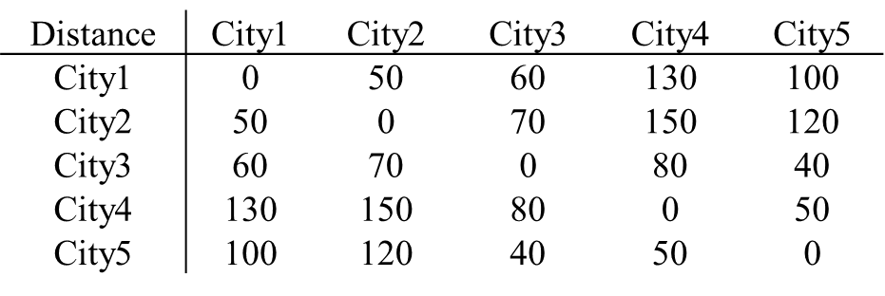
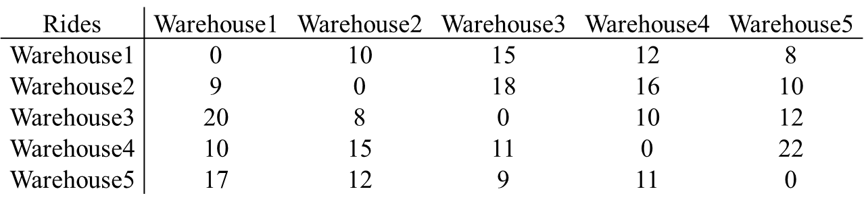
Models of designing production systems
Placement of facilities
Facility location problem – quadratic assignment problem
Example
The company intends to build 5 warehouses in 5 cities. In the first table the distances (in km) between the cities are given, in the second table the number of drives that must be made between the warehouses in one month. The aim is to decide which warehouse will be set up in which city in order to minimize the total transportation costs.

Slide 40
Models of designing production systems
Product schedule
Basic terms and notation
Batch and mass production.
Each product requires the same sequence of operations.
The operations take place on facilities arranged in a production line.
All input parameters are integer values.
$A$ s$et of n$operations,
$t_{i}$ duration of $i$-th operation ($i=1,2,…,n),$
$A_{j}⊂A$ set of operations realized on $j$-th workplace ($j=1,2,…,m),$
$c$ takt time,
$i→k$ precedence relation, $i$-th operations precedes $k$-th operation ($i,k=1,2,…,n;i≠k),$
$z$ number of unused (idle) time units on the whole line,
$z_{j}$ number of unused (idle) time units on $j$-th workplace ($j=1,2,…,m)$.

Slide 41
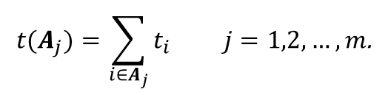

Models of designing production systems
Product schedule
Basic terms and notation
Product workload
Sum of durations of opertions on 𝑗-th workplace
$$t=\sum_{i=1}^{n}{t_{i}}.$$
$$t(A_{j})=\sum_{i∈A_{j}}{t_{i}} j=1,2,…,m\text{.}$$

Slide 42
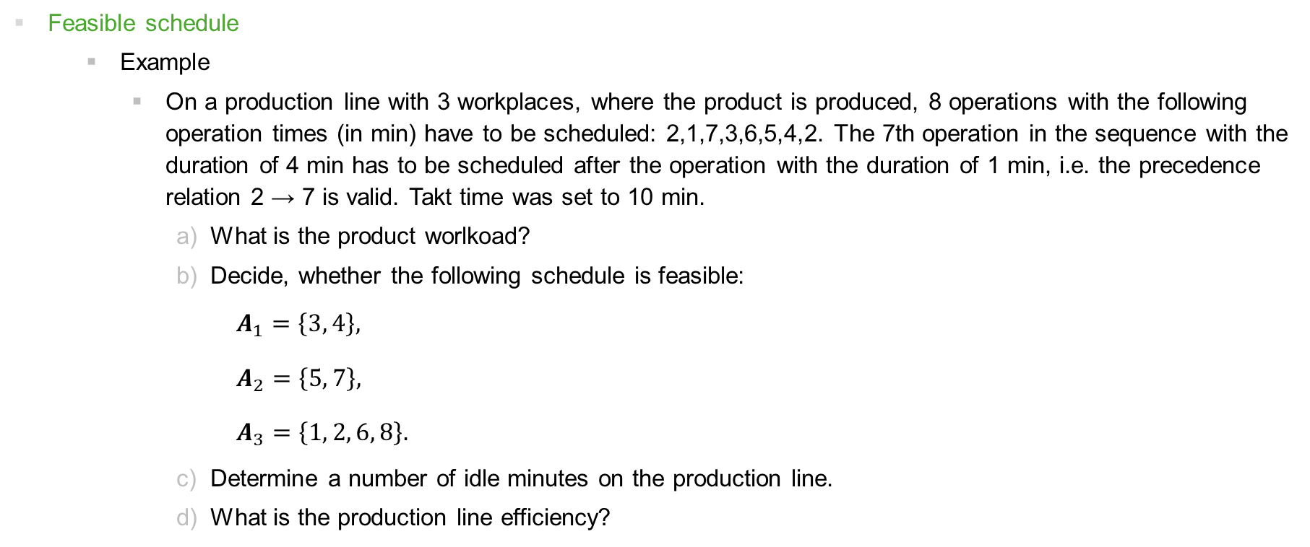
Models of designing production systems
Product schedule
Feasible schedule
Example
On a production line with 3 workplaces, where the product is produced, 8 operations with the following operation times (in min) have to be scheduled: 2,1,7,3,6,5,4,2. The 7th operation in the sequence with the duration of 4 min has to be scheduled after the operation with the duration of 1 min, i.e. the precedence relation 2 → 7 is valid. Takt time was set to 10 min.
What is the product worlkoad?
Decide, whether the following schedule is feasible:
$A_{1}=\left\{3, 4\right\},$
$A_{2}=\left\{5, 7\right\},$
$A_{3}=\left\{1, 2, 6, 8\right\}.$
Determine a number of idle minutes on the production line.
What is the production line efficiency?

Slide 43
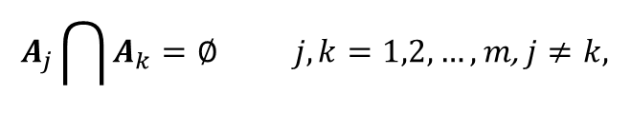


Models of designing production systems
Product schedule
Feasible schedule
Conditions for a feasible schedule
All operations must be scheduled
Each operation must be assigned to exactly one workplace
All operation assigned to a workplace must be done in takt time
All precedence constraints must be satisfied
$$\bigcup_{j=1}^{m}{A_{j}}=A,$$
$$A_{j}\bigcap{A_{k}}=∅ j,k=1,2,…,m\text{, }j≠k,$$
$$t(A_{j})≤c j=1,2,…,m\text{.}$$
$$i→h, i∈ A_{j}∧h∈ A_{k}⇒j≤k \begin{matrix}i,h=1,2,…,n\text{,} \\ j,k=1,2,…,m.\end{matrix}$$

Slide 44



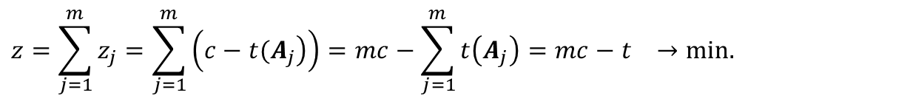
Models of designing production systems
Product schedule
Optimal schedule
Criteria
Minimization of a number of workplaces for given value of takt time
Minimization of takt time for given number of workplaces
Minimization of idle time on the whole production line
Maximization of the production line efficiency
$$m→min⁡ \text{pro} c=\text{c}\text{onst}\text{.}$$
$$c→min⁡ \text{pro} m=\text{c}\text{onst}\text{.}$$
$$z=\sum_{j=1}^{m}{z_{j}}=\sum_{j=1}^{m}{\left(\left.c−t(A_{j}\right)\right)}=mc−\sum_{j=1}^{m}{t\left(A_{j}\right)}=mc−t →min.$$
$$E=\frac{t}{mc}100 \% → \text{max}\text{.}$$

Slide 45










Models of designing production systems
Product schedule
Minimization of a number of workplaces
Generally:
For :
For :
If a takt time is given c = const., then
$$1≤m≤n.$$
$$m=1$$
$$c=t$$
$$z=z_{1}=0$$
$$E=100 \%$$
$$m=n$$
$$\left\lceil x\right\rceil ceiling$$
$$c=t_{max}=\max_{i=1,2,…,n}{t_{i}}$$
$$\left\lfloor x\right\rfloor floor$$
$$1≤m_{min}≤m≤m_{max}≤n$$
$$m_{min}=\left\lceil \frac{t}{c} \right\rceil$$
$$m_{max}=\left\lceil \frac{t}{t_{max}} \right\rceil$$

Slide 46
Models of designing production systems
Product schedule
Minimization of a number of workplaces
Example
The company wants to schedule a product on the line, the production consists of 6 operations with durations (in min): 2,4,6,3,5,3. There are no technological interdependencies between the operations, i.e. no precedence relation is defined. The takt time is set to 8 min.
What is a product workload?
Determine minimal and maximal number of workplaces on production line and find any feasible schedule.
For found schedule, determine a number of idle minutes on the whole production line and calculate its efficiency.

Slide 47







Models of designing production systems
Product schedule
Minimization of takt time
Generally:
For :
For :
For $1<m<n$:
Theoretically achievable minimum takt time:
$$1≤c≤t.$$
$$m=1$$
$$c=t$$
$$E=100 \%$$
$$m=n$$
$$if t_{i}=1 \text{for} \text{all} i=1,2,…,n$$
$$c=1$$
$$E=100 \%$$
$$c_{min}=max\left(\left\lceil \frac{t}{m} \right\rceil ,t_{max}\right)$$

Slide 48


Models of designing production systems
Product schedule
Minimization of takt time
Highest possible takt time at which required production size 𝑄 can be achieved in working period of legth 𝑇:
Realized takt time:
$$c_{max}=\left\lfloor \frac{T}{Q} \right\rfloor .$$
$$1≤c_{min}≤c≤c_{max}≤t.$$

Slide 49
Models of designing production systems
Product schedule
Minimization of takt time
Example
The company wants to schedule a product with 5 operations and their durations (in min): 5,1,3,4,2 on 3 workplaces. There is no precedence relation between the operations.
What is the theoretically achievable minimum takt time?
Find a feasible schedule for this value.
What is the production line efficiency?
How do the takt time and the production line efficiency change for durations: 2,2,2,5,4?

Slide 50
Models of designing production systems
Product schedule
Minimization of takt time
Example
The company plans to achieve the daily production size 𝑄=100 units in the working period of length 𝑇=9 hours. Production of the product consists of 7 operations with durations (in min): 2,4,5,4,3,1,2.
What is the highest possible takt time at which the desired daily production can still be achieved?
Is it possible to find a feasible schedule for this takt time with the existing 5 workplaces?
What will be the efficiency of the whole production line?

Slide 51
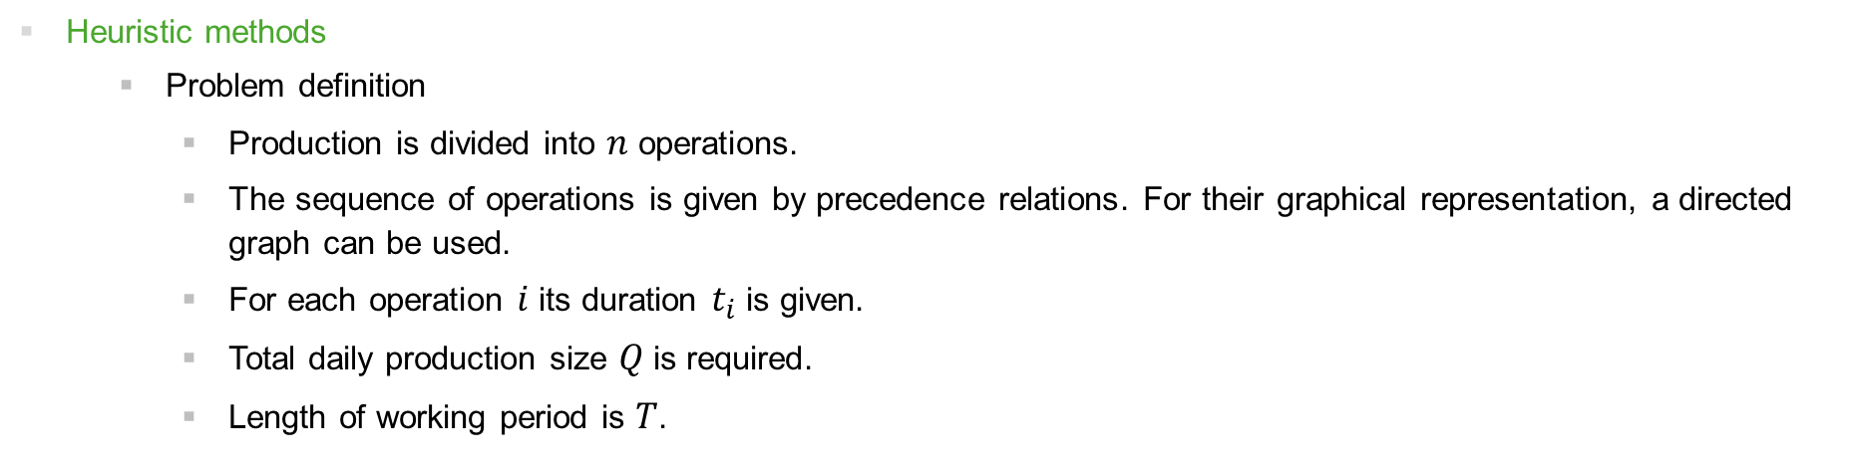
Models of designing production systems
Product schedule
Heuristic methods
Problem definition
Production is divided into $n$ operations.
The sequence of operations is given by precedence relations. For their graphical representation, a directed graph can be used.
For each operation $i$ its duration $t_{i}$ is given.
Total daily production size $Q$ is required.
Length of working period is $T$.

Slide 52




Models of designing production systems
Product schedule
Heuristic methods
General procedure
Step 1
Calculate maximal takt time:
Step 2
Calculate product workload and theoretical minimal number of workplaces:
Step 3
Use one of 4 rules to assign operations to individual workplaces (see below).
Step 4
Calculate the production line efficiency:
$$c_{max}=\left\lfloor \frac{T}{Q} \right\rfloor .$$
$$t=\sum_{i=1}^{n}{t_{i},}$$
$$m_{min}=\left\lceil \frac{t}{c_{max}} \right\rceil .$$
$$E=\frac{t}{mc}100 \%.$$

Slide 53
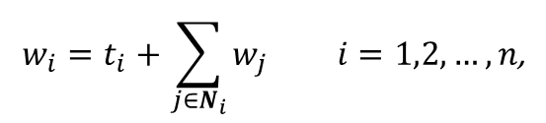

Models of designing production systems
Product schedule
Heuristic methods
Rules for the assignment of operations to workplaces (see step 3):
longest duration,
maximal number of predecessors,
maximal number of successors,
maximal weight:
where $N_{i}$ is a set of all immediate successors of $i$-th operation.
$$w_{i}=t_{i}+\sum_{j∈N_{i}}{w_{j}} i=1,2,…,n\text{,}$$

Slide 54
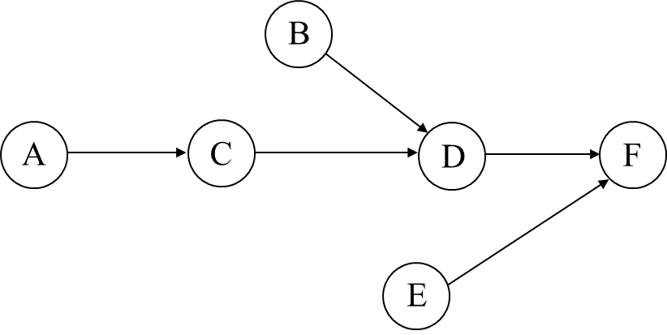
Models of designing production systems
Product schedule
Heuristic methods
Example
The company plans to produce 12 units of product per day, which production consists of 6 operations. All precedence relations are illustrated by the directed graph in the figure.

Slide 55
Models of designing production systems
Product schedule
Heuristic methods
Example – continued
The table specifies the duration of each operation. In addition, the sets of the immediately preceding and immediately following operations are obtained from the graph. For further calculation, the numbers of all preceding and all following operations are additionally determined in the table for each activity. The length of the daily working period is 6 hours.

Slide 56
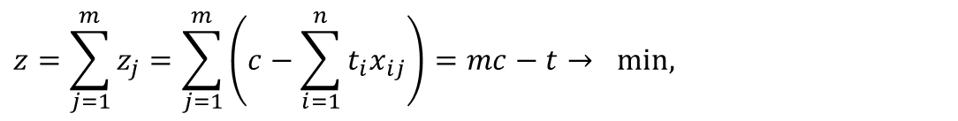
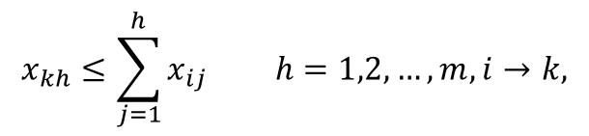
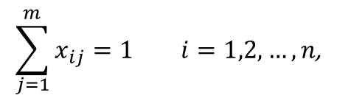

Models of designing production systems
Product schedule
Mathematical model
$$z=\sum_{j=1}^{m}{z_{j}}=\sum_{j=1}^{m}{\left(c−\sum_{i=1}^{n}{t_{i}x_{ij}}\right)}=mc−t→ min,$$
$$\sum_{i=1}^{n}{t_{i}x_{ij}}≤c j=1,2,…,m\text{,}$$
$$\sum_{j=1}^{m}{x_{ij}}=1 i=1,2,…,n\text{,}$$
$$x_{kh}≤\sum_{j=1}^{h}{x_{ij}} h=1,2,…,m,i→k,$$

Slide 57

Models of management of production systems
3

Slide 58
Models of management of production systems
Management of production systems
Steps of management od production systems
Production planning – determination of production capacity in the long term.
Production scheduling – the schedulling of production to individual facilities over a shorter time horizon.
Production control – implementation of schedules, done in real time.

Slide 59
Models of management of production systems
Production planning
Planning of aggregated production
Satisfaction of demand.
Demand size is determined in aggregated units → production size is also determined in aggregated units.
Assessment of production capacities and their possible increase.
Demad forecasts
Business plan
Product mix determination
Determination of resource availability
Setting up a supply chain

Slide 60

Models of management of production systems
Production planning
Planning of aggregated production
Decision-making problem
Strategies for setting of control variables:
Constant level. We do not change $W_{t}$ and, therefore, neither $P_{t}$. There may be overproduction (higher storage costs) or underproduction (lost profits) relative to demand.
Tracking strategy. Responding to the size of demand by changing workforce level $W_{t}$so that production size $P_{t}$matches the change in the size of demand as closely as possible. Higher costs associated with firing and hiring workers.
Combined strategy. Partial tracking of demand size to use both approaches.
$D_{t}$ size of aggregated demand in period $t$,
$P_{t}$ production size in period $t$,
Control variables
$W_{t}$ level of human resources (workforce) in period $t$,
$I_{t}$ inventory level in period $t$.

Slide 61
Models of management of production systems
Production planning
Planning of aggregated production
Mathematical model
$N$ number of groups into which the products are sorted ($i=1,2,…,N$),
$T$ number of periods into which the time horizon is divided ($t=1,2,…,T$),
$M$ number of source types ($m=1,2,…,M$),
$D_{it}$ demand forecast for products group $i$in periods $t$,
$R_{mt}$ capacity of the source of type $m$in period $t$,
$r_{im}$ number of units of the source type $m,$ required by the products group $i$,
$I_{it}$ inventory level of products group $i$ at the end of period $t$,
$I_{i0}$ initial inventory level of products group $i$,
$I_{it}^{∗}$ safety stock of products group $i$ at the end of period $t$,
$c_{i}$ unit holding cost for products group $i$ per time period,
$x_{it}$ production size for products group $i$ in period $t$.

Slide 62





Models of management of production systems
Production planning
Planning of aggregated production
Mathematical model – continued
$$z=\sum_{t=1}^{T}{\sum_{i=1}^{N}{c_{i}}I_{it}} →min\text{,}$$
$$I_{i,t−1}+x_{it}−I_{it}=D_{it} \begin{matrix}i=1,2,…,N\text{,} \\ t=1,2,…,T,\end{matrix}$$
$$\sum_{i=1}^{N}{r_{im}x_{it}}≤R_{mt} \begin{matrix}m=1,2,…,M\text{,} \\ t=1,2,…,T,\end{matrix}$$
$$I_{it}≥I_{it}^{∗} \begin{matrix}i=1,2,…,N\text{,} \\ t=1,2,…,T,\end{matrix}$$
$$x_{it}≥0 \begin{matrix}i=1,2,…,N\text{,} \\ t=1,2,…,T\text{.}\end{matrix}$$

Slide 63


Models of management of production systems
Production planning
Planning of aggregated production
Mathematical model – extension for overloading sources
$s_{mt}$ size of the overload of the source type $m$in period $t$,
$p$ penalty for the overload of the source,
$$\sum_{i=1}^{N}{r_{im}x_{it}}≤R_{mt}+s_{mt} \begin{matrix}m=1,2,…,M\text{,} \\ t=1,2,…,T,\end{matrix}$$
$$z=\sum_{t=1}^{T}{\left(\sum_{i=1}^{N}{c_{i}}I_{it}+p\sum_{m=1}^{M}{s_{mt}}\right)}→min.$$

Slide 64

Models of management of production systems
Production planning
Multi-level planning
Techniques
Input-output analysis
Material Requirement Planning (MRP).
Manufacturing Resource Planning (MRP II).
Gozinto graph
Nodes
Inputs: material, semi-finished products.
Outputs: semi-finished products, final products.
Arcs (directed)
Transformation of material and products.
Arcs evaluation: number of the input units transformed to the output unit.

Slide 65




Models of management of production systems
Production planning
Multi-level planning
Input-output analysis
Leontief model:
Optimization model:
$A$ input-output matrix of coefficients $a_{ij}$ (amount of $i$-th input item necessary to produce a unit of $j$-th output item),
$b$ vector of required size of final production,
$y$ vector of all production input and output values,
$y={\left(I−A\right)}^{−1}b$.
$$z=f\left(y \right)→min (\text{max}),$$
$$\left(I−A)y=b,\right.$$
$$y≥0.$$

Slide 66
Models of management of production systems
Production planning
Multi-level planning
Input-output analysis
Example
The company produces two final products V1 and V2 in 20 and 30 units. Two types of materials M1 and M2 and semi-finished product P are used. Product structure is expressed by Gozinto graph. Calculate all production input and output values:
Use the Leontief model.
Use the optimization model.

Slide 67


Models of management of production systems
Production planning
Multi-level planning
Input-output analysis
Example – continued

Slide 68
Models of management of production systems
Production planning
Multi-level planning
MRP
MPS – Master Production Schedule
Transformation of aggregated plan into detailed production plan.
What will be produced, when and in what sizes (special products and capacity requirements during the considered time period are determined).
BOM – Bill of Materials
List of all materials, components and semi-finished products.
Assembly tree of product structure (Gozinto graph).
Inventory levels (stock), delivery times (lead times), orders, safety stock levels.

Slide 69

Models of management of production systems
Production planning
Multi-level planning
MRP
Example
For 1 unit of product V, 1 unit of material M1, 2 units of material M2 and 4 units of material M3 are required. The delivery times (DT, in weeks) for each material type and for product V (production time) are shown in the figure (Gozinto graph). Product V can start production when all the material is available. The company has to deliver 80 units of product V in week 4 and 160 units of product V in week 7. The initial inventory level is 50 units of product V, 50 units of material M1, 40 units of material M2 and 140 units of material M3. The objective is to plan the material requirements for the whole period so that the demand for product V is met.

Slide 70

Models of management of production systems
Production planning
Multi-level planning
MRP
Example – continued

Slide 71

Models of management of production systems
Production planning
Multi-level planning
MRP
Example – continued

Slide 72

Models of management of production systems
Production scheduling
Basic terms
Elements
machines (processors): $P_{1}, P_{2},…,P_{m}$or $1,2,…,m,$
jobs: $D_{1}, D_{2},…,D_{n}$or $1,2,…,n,$
Model classification
Number of machines
single machine models,
multiple machine models, machines are arranged in parallel or in series.
Random consideration:
deterministic models,
stochastic (probabilistic) models.
Knowledge of all jobs:
static,
dynamic.

Slide 73


Models of management of production systems
Production scheduling
Basic terms
Precedence constraints (relations)
Expression of relationship between jobs during processing.
$D_{j}→D_{k}$ means that processing of job $D_{k}$can start after processing $D_{j}$ is completed.
Precedence graph – graphical representation of all precedence relations in the problem.

Slide 74
Models of management of production systems
Production scheduling
Basic terms
Preemptions
the division of a job into two or more time intervals with a time gap between them,
it is allowed to interrupt the processing of a job at any point in time and continue processing on another machine,
interruption of the job usually occurs after the completion of an ongoing operation.
Idle period
a time interval in which no job is processed, i.e. no operation is performed,
the idle period may be planned (machines maintenance), it may occur due to inefficient balancing of the production line, it may be forced (failures).
Schedule
arrangement of jobs in time,
Gantt chart is a graphical representation of the schedule of jobs on a time axis.

Slide 75
Models of management of production systems
Production scheduling
Basic terms
Models of network analysis (project management)
a single job, called a project,
operations are called activities,
each activity runs on a separate machine,
the relationship of activities can be expressed by a network,
time and cost analysis of projects, scheduling of shared resources.

Slide 76

Models of management of production systems
Production scheduling
Production scheduling models
Notation in models
Given parameters are denoted by lowercase characters.
Variables and calculated values are denoted by uppercase characters.
Parameters – for each job $D_{j}$ it is possible to set the following data $(j=1,2,…,n)$
$t_{j}$ Processing time of job $j.$ If a job consists of several operations, their durations are known as well.
$r_{j}$ Release time (ready time), it is the earliest time at which job $j$ can start its processing.
$d_{j}$ Due time of job $j.$ It is committed completion time. Completion a job after its due time is allowed, but then a penalty is incurred. When a due time must be met, it is referred to as a deadline.
$w_{j}$ Weight of job $j$ to express it importance (e.g. unit cost or penalty for delay performed).

Slide 77
Models of management of production systems
Production scheduling
Production scheduling models
Feasible schedule
No machine can process multiple jobs simultaneously.
No job can be processed on multiple machines simultaneously.
No job processing can start before its release time.
All precedence relations must be respected for all jobs.
Other conditions must be respected
no interruption is allowed in processing,
jobs must be processed on a special machine,
due times must be respected as deadlines,
etc.

Slide 78


Models of management of production systems
Production scheduling
Production scheduling models
Example
Consider 6 jobs whose precedence graph is shown in the figure. Schedule these jobs on 2 parallel machines. The table shows the processing times of all jobs (in hours).

Slide 79


Models of management of production systems
Production scheduling
Production scheduling models
Example – continued
3 idle periods
1 idle period
time
time

Slide 80







Models of management of production systems
Production scheduling
Production scheduling models
Variables (calculated values)
completion time of $j$-th job,
flow time determines time that $j$-th job spends in system,
lateness of job$j$ is a difference between completion time and due time,
for earliness it is valid: $L_{j}<0$,
for tardiness it is valid: $L_{j}>0$,
tardiness of job $j$,
if $T_{j}>0,$
if $T_{j}=0$.
Optimal production schedule is such a feasible schedule, which minimizes selected criterion.
$$C_{j}$$
$$F_{j}=C_{j}−r_{j}$$
$$L_{j}=C_{j}−d_{j}$$
$$T_{j}=max\left({0,L}_{j}\right)$$
$${δ(T}_{j})=1$$
$${δ(T}_{j})=0$$

Slide 81






Models of management of production systems
Production scheduling
Production scheduling models
Criteria:
Makespan is time all jobs will have been completed, i.e. completion time of last processed job
Mean completion time
Maximal flow time (makespan)
$$C_{max}=\max_{j=1,2,…,n}\left\{C_{j}\right\},$$
$$C_{max}\left(w\right)=\max_{j=1,2,…,n}\left\{w_{j}C_{j}\right\}.$$
$$\overline{C}=\frac{1}{n}\sum_{j=1}^{n}{C_{j}},$$
$$\overline{C}\left(w\right)=\sum_{j=1}^{n}{w_{j}C_{j}}.$$
$$F_{max}=\max_{j=1,2,…,n}\left\{F_{j}\right\},$$
$$F_{max}\left(w\right)=\max_{j=1,2,…,n}\left\{w_{j}F_{j}\right\}.$$

Slide 82






Models of management of production systems
Production scheduling
Production scheduling models
Criteria:
Mean flow time
Maximum lateness
Mean lateness
$$\overline{F}=\frac{1}{n}\sum_{j=1}^{n}{F_{j}},$$
$$\overline{F}\left(w\right)=\sum_{j=1}^{n}{w_{j}F_{j}}.$$
$$L_{max}=\max_{j=1,2,…,n}\left\{L_{j}\right\},$$
$$L_{max}\left(w\right)=\max_{j=1,2,…,n}\left\{w_{j}L_{j}\right\}.$$
$$\overline{L}=\frac{1}{n}\sum_{j=1}^{n}{L_{j}},$$
$$\overline{L}\left(w\right)=\sum_{j=1}^{n}{w_{j}L_{j}}.$$

Slide 83






Models of management of production systems
Production scheduling
Production scheduling models
Criteria:
Maximum tardiness
Mean tardiness
Number of overdue jobs
$$T_{max}=\max_{j=1,2,…,n}\left\{T_{j}\right\},$$
$$T_{max}\left(w\right)=\max_{j=1,2,…,n}\left\{w_{j}T_{j}\right\}.$$
$$\overline{T}=\frac{1}{n}\sum_{j=1}^{n}{T_{j}},$$
$$\overline{T}\left(w\right)=\sum_{j=1}^{n}{w_{j}T_{j}}.$$
$$N=\sum_{j=1}^{n}{\left.{δ(T}_{j}\right)},$$
$$N\left(w\right)=\sum_{j=1}^{n}{w_{j}{δ(T}_{j}}).$$

Slide 84







Models of management of production systems
Production scheduling
Production scheduling models
Model classification
system with single machine,
system with m parallel machines,
flow-shop system with m serial machines, all jobs are processed in the same order (production line in mass production),
open-shop system, system with m serial machines, jobs are processed in any order,
job-shop system, system with m serial machines, each job is processed in fix order, but this order can differ for each job (production to order/contract).
$$α\left|β\right|γ$$
$α$:
$$1$$
$${\text{P}}_{m}$$
$$F_{m}$$
$$O_{m}$$
${\text{J}}_{m}$

Slide 85





Models of management of production systems
Production scheduling
Production scheduling models
Model classification
release times of jobs do not have to be zero,
jobs processing can be interrupted,
in the model precedence relations are defined,
selected criterion.
$$α\left|β\right|γ$$
$β$:
$$r_{j}$$
$$prmp$$
$$prec$$
$$γ:$$

Slide 86

Models of management of production systems
Production scheduling
Single machine scheduling models
Model 1||𝑍
There is single processor in the system.
There are $n$jobs processed, each consists of one operation.
Symbol 𝑍 represents generally any criterion.
For each job$j=1,2,…,n$ processing time $t_{j}$ is given.
Constraints:
S₁: At the beginning, all $n$ jobs are available, i.e. for each job$j=1,2,…,n$ ready time is $r_{j}=0$.
S₂: There are no precedence relations between jobs.
S₃: Processing times of jobs are independent of the order of their processing.
No interruptions of jobs are allowed, there are no idle times in the schedule.
Notation $"\left[i\right]=j"$ means that $j$-th job is processed in $i$-th place in order of the schedule.

Slide 87




Models of management of production systems
Production scheduling
Single machine scheduling models
Model 1||$F_{max}$
All optimal schedules are equivalent.
Criterion value (maximal flow time) is independent of the order of jobs in schedule:
A mathematical model for considering all due times as deadlines:
$$F_{max}=\sum_{j=1}^{n}{t_{j}}.$$
$$d_{j}^{+}$$
tardiness of job
$$d_{j}^{−}$$
lateness of job

Slide 88










Models of management of production systems
Production scheduling
Single machine scheduling models
Model 1||$F_{max}$ – continued
$$z_{0}=0$$
no job is overdue
$$z=\sum_{j=1}^{n}{d_{j}^{+}, } →min\text{,}$$
$$z_{0}>0$$
at least one job is overdue
$$C_{j}≤F_{max} j=1,2,…,n\text{, }$$
$$C_{i}+t_{j}≤C_{j}+M(1−x_{ij}) i,j=1,2,…,n\text{, }i≠j,$$
$$x_{ij}+x_{ji}=1 i,j=1,2,…,n\text{, }i≠j,$$
$$C_{j}−d_{j}^{+}+d_{j}^{−}=d_{j} j=1,2,…,n\text{, }$$
$$C_{j}≥t_{j} j=1,2,…,n\text{, }$$
$$d_{j}^{+},d_{j}^{−}≥0 j=1,2,…,n\text{, }$$
$$x_{ij}∈\left\{0,1\right\} i,j=1,2,…,n\text{. }$$

Slide 89




Models of management of production systems
Production scheduling
Single machine scheduling models
Model 1||$F_{max}$ – continued
Example
Consider 5 jobs for which you know their processing time (in hours), their due time (in hours) and their relative importance in terms of weight (see table). The ready times for all jobs are zero.
Job
$F_{max}$ = 12 hours
Total tardiness of jobs = 5 hours
time

Slide 90



Models of management of production systems
Production scheduling
Single machine scheduling models
Model 1||$F_{max}$ – continued
Example – continued
Alternative optimal schedule
Job
$F_{max}$ = 12 hours
Total tardiness of jobs = 1 hour
time

Slide 91




Models of management of production systems
Production scheduling
Single machine scheduling models
Model 1||$F_{max}(w)$
In the optimal schedule, the jobs are ordered in non-increasing sequence of their weights:
Example – continued
$$w_{\left[1\right]}≥w_{\left[2\right]}≥…≥w_{\left[n\right]}.$$
Job
$F_{max}(w)$ = 1,2 hour
time

Slide 92




Models of management of production systems
Production scheduling
Single machine scheduling models
Model 1||$\overline{F}$
The following property gives the optimal schedule:
Example – continued
$$t_{\left[1\right]}≤t_{\left[2\right]}≤…≤t_{\left[n\right]}.$$
Job
$\overline{F}$= 5,8 hour
time

Slide 93




Models of management of production systems
Production scheduling
Single machine scheduling models
Model 1||$\overline{F}(w)$
The following property gives the optimal schedule:
Example – continued
$$\frac{t_{\left[1\right]}}{w_{\left[1\right]}}≤\frac{t_{\left[2\right]}}{w_{\left[2\right]}}≤…≤\frac{t_{\left[n\right]}}{w_{\left[n\right]}}.$$
Job
$\overline{F}(w)$= 4,2 hour
time

Slide 94





Models of management of production systems
Production scheduling
Single machine scheduling models
Models 1||$L_{max}$ and 1||$T_{max}$
In the optimal schedule, the jobs are ordered in non-decreasing sequence of their due times:
Example – continued
$$d_{\left[1\right]}≤d_{\left[2\right]}≤…≤d_{\left[n\right]}.$$
Job
$L_{max}$ = $T_{max}$ = 1 hour
tardy job
$L_{j}$
time

Slide 95



Models of management of production systems
Production scheduling
Single machine scheduling models
Models 1||$L_{max}(w)$ and 1||$T_{max}(w)$
Lawler's algorithm (optimization approach)
Step 1
Calculate a value representing the total processing time of all jobs:
Set of unscheduled jobs is $U=\left\{1,2,…,n\right\}.$
Step 2
This step is about finding a job that will be scheduled to end at time $t.$
For this purpose, first calculate value $f_{j}$ for all jobs not yet scheduled:
$f_{j}=w_{j}\left(t−d_{j}\right), j∈U$, for criterion $L_{max}\left(w\right)$,
$f_{j}=w_{j}max\left(0,t−d_{j}\right), j∈U$, for criterion $T_{max}\left(w\right)$,
From all values calculated in this way, find the minimum value that corresponds to job $k$:
$$t=\sum_{j=1}^{n}{t_{j}}.$$
$$f_{k}={\min_{j∈U}{f}}_{j}.$$

Slide 96


Models of management of production systems
Production scheduling
Single machine scheduling models
Models 1||$L_{max}(w)$ and 1||$T_{max}(w)$ – continued
Lawler's algorithm – continued
Step 3
Job $k$ is scheduled to end at time $t,$ tj. $C_{k}=t.$
Modify the value of $t$ and the set of unscheduled jobs:
If $t=0$ or also $U=∅$ then the optimal schedule is found, otherwise go to step 2.
$$t=t−t_{k}, U=U\backslash \left\{k\right\}.$$

Slide 97




Models of management of production systems
Production scheduling
Single machine scheduling models
Models 1||$L_{max}(w)$ and 1||$T_{max}(w)$ – continued
Example – continued
Use of Lawler‘s algorithm for model 1||$T_{max}(w)$
Job
$T_{max}(w)$ = 0,2 hours
time

Slide 98




Models of management of production systems
Production scheduling
Single machine scheduling models
Model 1||$\overline{L}$
The following property gives the optimal schedule:
Example – continued
$$t_{\left[1\right]}≤t_{\left[2\right]}≤…≤t_{\left[n\right]}.$$
Job
$\overline{L}$= -1,8 hour
time

Slide 99





Models of management of production systems
Production scheduling
Single machine scheduling models
Model 1||$\overline{L}(w)$
The following property gives the optimal schedule :
Example – continued
$$\frac{t_{\left[1\right]}}{w_{\left[1\right]}}≤\frac{t_{\left[2\right]}}{w_{\left[2\right]}}≤…≤\frac{t_{\left[n\right]}}{w_{\left[n\right]}}.$$
Job
$\overline{L}\left(w\right)$ = -3,5 hour
time

Slide 100


Models of management of production systems
Production scheduling
Single machine scheduling models
Model 1||$N$
Moore's algorithm (optimization approach)
Step 1
Make the schedule using the following property:
Jobs in this order are sequenced into $E$. For overdue jobs the following set is introduced: $L=∅$.
Step 2
If sequence $E$ does not contain any overdue job, then sequence $E$ extended by jobs from set $L$ (in any order of jobs) generates optimal schedule $R$.
Number of overdue jobs is $N=\left|L\right|$, algorithm ends.
$$d_{\left[1\right]}≤d_{\left[2\right]}≤…≤d_{\left[n\right]}.$$

Slide 101


Models of management of production systems
Production scheduling
Single machine scheduling models
Model 1||$N$ – continued
Moore's algorithm – continued
Step 3
In sequence $E$, find the first overdue job. Let it be job $D_{[k]}$ on the place $k$of the order.
Among the first $k$ jobs, find job $D_{[m]}$with the longest processing time$t_{[m]}$:
Move job $D_{[m]}$ from sequence $E$ to set $L$ and goto step 2.
$$t_{\left[m\right]}={\max_{j=1,2,…,k}{t}}_{\left[j\right]}.$$

Slide 102





Models of management of production systems
Production scheduling
Single machine scheduling models
Model 1||$N$ – continued
Example – continued
The first (and the only one) overdue job is $D_{4}$, which is on the 4th palce in sequence $E$. Among the first 4 jobs, job $D_{1}$ has the longest processing time, therefore it is erased from sequence $E$ and it is added to set $L$. Because in modified sequence $E$ no job is overdue anymore, the algorithm ends.
Job
$E$ = (D₂, D₃, D₁, D₄, D₅)
$L_{j}$
time
$R$ = (D₂, D₃, D₄, D₅, D₁),
N = 1.

Slide 103


Models of management of production systems
Production scheduling
Extensions of basic single machine scheduling model
Model 1$\left|r_{j;}prmp\right|\overline{T}$
Ready times of jobs do not have to be zero (release of condition S₁).
Jobs can be interrupted.
Example
Consider 3 jobs for which we know the processing times, ready times and due times (all values are in hours).
Job

Slide 104




Models of management of production systems
Production scheduling
Extensions of basic single machine scheduling model
Model 1$\left|r_{j;}prmp\right|\overline{T}$ – continued
Example – continued
Schedule without an interruption, $\overline{T}$ = 2/3 hour
Schedule without an interruption, $\overline{T}$ = 1/3 hour
Schedule with the interruption, $\overline{T}$ = 0 hour
Job
time
time
time

Slide 105



Models of management of production systems
Production scheduling
Extensions of basic single machine scheduling model
Model 1${\left|prec\right|T}_{max}$
Technological dependence of jobs, expressed by means of precedence relations (release of condition S₂).
Extension of Lawler's algorithm (optimization approach).
Step 1
Calculate a value representing the total processing time of all jobs:
Set of unscheduled jobs is $U=\left\{1,2,…,n\right\}.$
Step 2
This step is about finding a job that will be scheduled to end at time $t$.
Let set $V⊆U$ contain jobs that have no successors or which successors are already scheduled, i.e. there is no job $i∈U\text{,}$ which is their successor.
For all jobs in set $V$ then calculate value $f_{j}=max\left(0,t−d_{j}\right), j∈V.$
From all values calculated in this way, find the minimum value that corresponds to job $k$:
$$t=\sum_{j=1}^{n}{t_{j}}.$$
$$f_{k}={\min_{j∈V}{f}}_{j}.$$

Slide 106


Models of management of production systems
Production scheduling
Extensions of basic single machine scheduling model
Model 1${\left|prec\right|T}_{max}$ – continued
Extension of Lawler's algorithm – continued
Step 3
Job $k$ is scheduled to end at time $t,$ tj. $C_{k}=t.$
Modify the value of $t$ and the set of unscheduled jobs:
If $t=0$ or also $U=∅$ then the optimal schedule is found, otherwise go to step 2.
$$t=t−t_{k}, U=U\backslash \left\{k\right\}.$$

Slide 107






Models of management of production systems
Production scheduling
Extensions of basic single machine scheduling model
Model 1${\left|prec\right|T}_{max}$ – continued
Example
Make a schedule for 6 jobs, given by the precedence graph. The table shows the processing times of the jobs and their due times (both values are in hours).
Optimal schedule: $\left(D_{2}, D_{1}, D_{4}, D_{3}, D_{5}, D_{6}\right)$
$T_{max}$ = 2 hour

Slide 108

Models of management of production systems
Production scheduling
Extensions of basic single machine scheduling model
Model 1${\left|s_{jk}\right|C}_{max}$
The setup times of jobs depends on their order in the schedule (release of condition S₃):
$s_{jk}$ setup time for start of processing job 𝑘 immediately following realization of job 𝑗.
The problem of finding the optimal schedule can be transformed into the problem of finding the jobs order that minimizes the total time of all setups.
Analogy with the travelling salesman problem, in which distances between locations correspond to setup times.

Slide 109







Models of management of production systems
Production scheduling
Extensions of basic single machine scheduling model
Model 1${\left|s_{jk}\right|C}_{max}$ – continued
Mathematical model
$$z=\sum_{j=1}^{n}{\sum_{k=1}^{n}{s_{jk}x_{jk}+}}\sum_{j=1}^{n}{t_{j}} → min\text{,}$$
$$\sum_{k=1}^{n}{x_{jk}}=1 j=1,2,…,n\text{,}$$
$$\sum_{j=1}^{n}{x_{jk}}=1 k=1,2,…,n\text{,}$$
$$u_{j}+1−(n−1)(1−x_{jk})≤u_{k} \begin{matrix}j=1,2,…,n\text{,} \\ k=2,3,…,n,\end{matrix}$$
$$x_{jk}∈\left\{0,1\right\} \begin{matrix}j=1,2,…,n\text{,} \\ k=1,2,…,n,\end{matrix}$$
$$u_{j}≥0 j=1,2,…,n\text{. }$$

Slide 110


Models of management of production systems
Production scheduling
Extensions of basic single machine scheduling model
Model 1${\left|s_{jk}\right|C}_{max}$ – continued
Nearest neighbor algorithm (heuristic method)
Step 1
Select any job (suppose the processing begins and ends with job 1), denote it as $i$. This job is included as the first job in the schedule, denoted as sequence $R$. In this step, therefore $R=\left(1\right)$.
Total processing time of all jobs including setup times is denoted as $t$. Set $t=t_{i}=t_{1}.$ All other jobs create a set of not yet scheduled jobs $U=\left\{2,3,…,n\right\}$.
Step 2
Find (among the jobs not yet scheduled) to job 𝑖 its "nearest neighbor", which is job 𝑘 with the minimal setup time:
$$s_{ik}={\min_{j∈U}{s}}_{ij}.$$

Slide 111


Models of management of production systems
Production scheduling
Extensions of basic single machine scheduling model
Model 1${\left|s_{jk}\right|C}_{max}$ – continued
Nearest neighbor algorithm
Step 3
Include job $k$ at the end of sequence $R$ and exclude it form set $U$. Modify the value of $t$ and replace index $i$ with index $k$:
If $U=∅$, go to step 4, otherwise go to step 2.
Step 4
Since, by assumption, the whole schedule ends by setup of the machine to job 1, modify the value of $t$ as follows:
Algorithm ends, sequence $R$ corresponds to the feasible schedule, the value of $t$ equals to the total processing time of all jobs including all setup times in the schedule.
$$R=R+\left(k\right),U=U\backslash \left\{k\right\},t=t+s_{ik}+t_{k},i=k.$$
$$t=t+s_{k1}.$$

Slide 112




Models of management of production systems
Production scheduling
Extensions of basic single machine scheduling model
Model 1${\left|s_{jk}\right|C}_{max}$ – continued
Example
The company wants to schedule 8 jobs on 1 machine so that they are completed in minimum time. The table shows the job processing times and the setup times between jobs (all values are in minutes).
Nearest neighbor method:
$R$ = (1,8,6,3,7,5,2,4),
$t$= 464 min.
Optimal schedule:
$R$ = (1,4,6,2,3,7,5,8),
$t$= 447 min.

Slide 113


Models of management of production systems
Production scheduling
Parallel machine models
Model $P_{m}|prmp|F_{max}$
There are $m$ identical processors arranged in parallel in the system.
There are $n$jobs processed, each consists of one operation, there are no precedence relations between jobs.
Ready times of all jobs are zero.
Jobs can be interrupted after finishing the realized operation and can continue on the same or another machine.
Notation $"\left[i\right]=j"$ means that $j$-th job is processed in $i$-th place in order of the schedule.
For the minimal makespan it is valid:
average occupancy time of machine
maximal processing time
$$F_{max}=max\left\{\frac{1}{m}\sum_{j=1}^{n}{t_{j};}\max_{j=1,2,…,n}{t_{j}}\right\}.$$

Slide 114

Models of management of production systems
Production scheduling
Parallel machine models
Model $P_{m}|prmp|F_{max}$ – continued
McNaughton‘s algorithm (optimization approach)
Step 1
Calculate the value of $F_{max}$. Assign job $D_{1}$to machine $P_{1}$at time 0.
Step 2
Assign (to the same machine) other jobs according to their ordinal numbers respecting $F_{max}$.
Three cases can occur:
All remaining jobs can be assigned to the machine, i.e. the last job assigned is job $D_{n}.$
Last assigned job$D_{k}$ is completed exactly on time$F_{max}.$
When job $D_{k}$ is assigned, the value of $F_{max}$ will be exceeded.

Slide 115

Models of management of production systems
Production scheduling
Parallel machine models
Model $P_{m}|prmp|F_{max}$ – continued
McNaughton‘s algorithm – continued
Step 3
Next, we proceed according to which case occurred in the previous step:
All jobs are scheduled, the algorithm ends.
Assign job$D_{k+1}$ to the next machine at time 0 and go to step 2.
Split job $D_{k}$ so that its first part will be completed on the scheduled machine at time$F_{max}$ and assign its remaining part to the next machine at time 0, go to step 2.
This procedure can lead to a maximum of $m−1$ interruptions.

Slide 116


Models of management of production systems
Production scheduling
Parallel machine models
Model $P_{m}|prmp|F_{max}$ – continued
Example
The problem is to schedule 10 jobs on 4 machines so that they are processed in minimum time, i.e. the makespan will be minimal. The table shows the processing times of the jobs (in min). The operations that make up each job have a duration of 1 min, so all jobs can be interrupted at any time after each minute of processing.

Slide 117



Models of management of production systems
Production scheduling
Parallel machine models
Model $P_{m}|prmp|F_{max}$ – continued
Example – continued
Calculate
Since the jobs can only be interrupted after the completion of the operation currently being performed, it is necessary to calculate the ceiling, i.e. 11 min, from the value 43/4.
$F_{max}=max\left\{\frac{43}{4};8\right\}$= $\frac{43}{4}$
real interruptions of jobs
time

Slide 118




Models of management of production systems
Production scheduling
Parallel machine models
Model $P_{m}|prmp|F_{max}$ – continued
Mathematical model for obtaining the schedule without the interruption of jobs (if it exists)
$$z=\sum_{i=1}^{m}{\sum_{j=1}^{n}{x_{ij}}} → max\text{,}$$
The objective is not necessary to obtain a feasible schedule
$$\sum_{j=1}^{n}{x_{ij}t_{j}}≤F_{max} i=1,2,…,m\text{,}$$
$$\sum_{i=1}^{m}{x_{ij}}=1 j=1,2,…,n.$$

Slide 119


Models of management of production systems
Production scheduling
Parallel machine models
Model $P_{m}|prmp|F_{max}$ – continued
Example – continued
time

Slide 120

Models of management of production systems
Production scheduling
Parallel machine models
Model $P_{m}||F_{max}$
Jobs cannot be interrupted.
Generalization of the mathematical model formulated for the model $P_{m}|prmp|F_{max}$
$F_{max}$is a variable, not a calculated constant, it is necessary to set integrality constraints (due to the continuity of operations in the job).
The objective is $z=F_{max}→min.$
Jobs cannot be interrupted.
NP-hard problem.

Slide 121


Models of management of production systems
Production scheduling
Parallel machine models
Model $P_{m}||F_{max}$ – continued
Example
The problem is to schedule 10 jobs on 4 machines so that they are processed in minimum time, i.e. the makespan will be minimal. The table shows the processing times of the jobs (in min). The operations that make up each job have a duration of 1 min, so all jobs can be interrupted at any time after each minute of processing.

Slide 122


Models of management of production systems
Production scheduling
Parallel machine models
Model $P_{m}||F_{max}$ – continued
Example – continued
time

Slide 123


Models of management of production systems
Production scheduling
Parallel machine models
Model $P_{m}||F_{max}$ – continued
Heuristic algorithm:
Step 1
Make the schedule using the following property:
Step 2
Select first $m$ jobs in the sequence from step 1 and assign them to machines at time 0.
Step 3
Select next job in the sequence and assign it after the last job to the machine, which is released first, i.e. after the job, which of all the last jobs on the machines ends first.
Repeat this process until all jobs are scheduled.
$$t_{\left[1\right]}≥t_{\left[2\right]}≥…≥t_{\left[n\right]}.$$

Slide 124

Models of management of production systems
Production scheduling
Parallel machine models
Model $P_{m}||F_{max}$ – continued
Example – continued
time

Slide 125


Models of management of production systems
Production scheduling
Parallel machine models
Model $P_{m}||\overline{F}$
The same principle as the optimization procedure for the model $1||\overline{F}$:
Step 1
Make the schedule using the following property :
Step 2
Select first $m$ jobs in the sequence from step 1 and assign them to machines at time 0.
Step 3
Select next job in the sequence and assign it after the last job to the machine, which is released first, i.e. after the job, which of all the last jobs on the machines ends first.
Repeat this process until all jobs are scheduled.
$$t_{\left[1\right]}≤t_{\left[2\right]}≤…≤t_{\left[n\right]}.$$

Slide 126



Models of management of production systems
Production scheduling
Parallel machine models
Model $P_{m}||\overline{F}$ – continued
Example – continued
$\overline{F}$ = 6,3 min
time

Slide 127

Models of management of production systems
Production scheduling
Flow shop scheduling
Model${ F}_{m}||C_{max}$
There are $m$ serial machines in the system.
There are $n$jobs processed, each consists of $m$ operations, each of them is processed on one machine.
The jobs must be processed on the machines in the same order, i.e. 𝑖-th operation of each job is processed on 𝑖 -th machine.
Processing time of $i$-th operation of $j$-th job is denoted as $t_{ij}.$
No machine can process more than one job at a time, and no job can be processed on multiple machines simultaneously.

Slide 128

Models of management of production systems
Production scheduling
Flow shop scheduling
Model${ F}_{m}||C_{max}$ – continued
Constraints:
S₁ : Ready times for all jobs and machines are 0.
S₂ : There are no precedence relations between jobs.
S₃ : Processing times of jobs are independent of the order of their processing on the machine.
S₄ : Operations cannot be interrupted.

Slide 129


Models of management of production systems
Production scheduling
Flow shop scheduling
Model${ F}_{m}||C_{max}$ – continued
Example
Find a feasible schedule for 5 jobs that need to be scheduled on 3 serially arranged machines. The table contains the job processing times (in min) on each machine.

Slide 130


Models of management of production systems
Production scheduling
Flow shop scheduling
Model${ F}_{m}||C_{max}$ – continued
Example – continued
Feasible schedule:
time

Slide 131



Models of management of production systems
Production scheduling
Flow shop scheduling
Model${ F}_{m}||C_{max}$ – continued
Johnson‘s algorittm (optimization approach) for the problem with 2 machines
Step 1
Set of jobs is split to two subsets:
Step 2
Order jobs in set $U$ to the non-decreasing sequence ($U$) of operation processing times $t_{1j}$. Order jobs in set $V$ to the non-increasing sequence ($V$) of operation processing times $t_{2j}$.
Step 3
Optimal jobs schedule ($R$) on both machines consists of sequence ($U$) followed by sequence ($V$). Value $C_{max}$ is given by the completion time of the last job in sequence ($V$) on the second machine.
$$U=\left\{D_{j}\left|t_{1j}<t_{2j}\right.\right\},$$
$$V=\left\{D_{j}\left|t_{1j}≥t_{2j}\right.\right\}.$$

Slide 132


Models of management of production systems
Production scheduling
Flow shop scheduling
Model${ F}_{m}||C_{max}$ – continued
Example
Let 6 jobs be given, which must be scheduled to 2 serially arranged machines. The table shows the processing times (in min) of the jobs on both machines. The objective is to minimize the completion time of all batches.

Slide 133





Models of management of production systems
Production scheduling
Flow shop scheduling
Model${ F}_{m}||C_{max}$ – continued
Example – continued
Step 1
Step 2
Step 3
$$U=\left\{D_{2},D_{3},D_{5} \right\},$$
$$V=\left\{D_{1},D_{4},D_{6} \right\}.$$
$$\left(U\right)=\left(D_{2},{D_{5},D}_{3}\right),$$
$\left(V\right)=\left({D_{6},D}_{1},D_{4}\right)$.
$\left(R\right)=\left(D_{2},{D_{5},D}_{3},{D_{6},D}_{1},D_{4}\right)$,
$C_{max}$ =15.
time

Slide 134

Computer simulation
4

Slide 135
Computer simulation
Introduction to computer simulation
Definition
Representation of a real (but also planned, not yet existing) system with its stochastic and dynamic processes in the form of a simulation model.
The basic idea is to simulate the behaviour of a real system through a simulation model and, based on experimentation with this model, to propose changes that will improve the functioning of the system.
Areas of application of computer simulation
Optimization of large-scale production systems.
Analysis of logistics processes inside a company or within the entire supply chain.
Optimization of warehousing processes.
Optimization of production scheduling.
Improvement of communication systems, optimization of information flows.

Slide 136
Computer simulation
Introduction to computer simulation
Costs associated with computer simulation
Staff costs for a qualified analyst and programmer.
Costs associated with managers' time spent communicating with the analyst during the project.
The cost of powerful computing equipment (HW).
Costs for software.
Data collection costs.

Slide 137
Computer simulation
Introduction to computer simulation
Simulation project
Problem recognition and goals setting.
Creation of a conceptual model (CM).
Data collection and analysis.
Creation of a simulation model (SM).
Verification and validation of the model (checking whether the SM is consistent with the original CM and whether the SM is in compliance with the reality).
Performing experiments.
Analysis of results.
Creation of project documentation.
Implementation of results.

Slide 138
Computer simulation
Data analysis
Basic analytical tools
tables,
diagrams,
charts,
schemes.
General methods of processing data
Clustering – the goal is to sort the data into groups (clusters) so that the elements of each group share a common attribute (car type, car-body type, color).
Filtering – selection of elements that meet the specified conditions (simple filters, multiple filters).
Sorting - sorting data according to the values of one or more attributes (the so-called key), the result is the order of elements.
Pairing - combining information (character values) from several databases or lists obtained, for example, on the basis of passing products through individual check points.

Slide 139
Computer simulation
Data analysis
Software
Access, Excel, SAS, SPSS, Gretl, Statgraphics, MATLAB, R.
Statistical data analysis
(Random) Experiment – an experiment that can be repeated and the outcome of which is not known in advance.
Random variable – variable whose value is given by the result of an experiment (discrete, continuous).
(Random) Event – the result of an experiment expressed by the value of a random variable. .
Probability of a random event – numerical expression of the degree of possibility of occurrence of a random event.
Probability distribution –a rule that assigns to each value or interval of values the probability that a random variable will take on that value or a value from that interval.

Slide 140




Computer simulation
Data analysis
Statistical data analysis
Random number is defined as the value of a uniform probability distribution on the interval (0, 1). Several generators have been developed to generate random numbers, the most commonly used of which are arithmetic generators. Random numbers are obtained by calculating each number using some arithmetic operation from the previous number. Since this is an arithmetic calculation and not a random operation, numbers obtained in this way can only be described as pseudo-random numbers. The random numbers generated are then transformed by various methods into values of random variables.
The inverse transformation method is one of the methods used to convert a random number 𝑟 into values of a random variable 𝑋. Example for values of a uniform probability distribution on the interval $\left(a,b\right):$
$$F\left(x\right)=\frac{x−a}{b−a}$$
cumulative distribution function on the interval $(a,b)$,
$$r=\frac{x−a}{b−a}$$
random number,
$$x=a+r(b−a)$$
value of random variable with uniform probability distribution.

Slide 141


Thank you for attention
Jan Fábry
Department of Production, Logistics and Quality Management
fabry@savs.cz www.janfabry.cz

